Slide 1
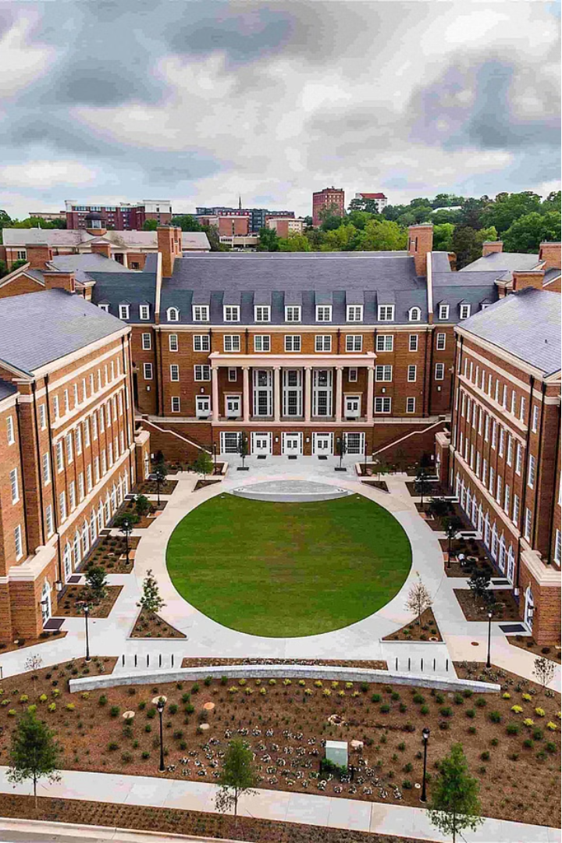


Automated Counseling System using Machine Learning
This presentation explores an innovative project that uses machine learning to help students with college admissions. The project is carried out by Shailesh Gaikwad, Gajanan Sadgire, and Mauli Gundekar, under the guidance of Prof. S.M. Jatti. The goal of the project is to make the college selection process easier and more accurate by analyzing data and using advanced algorithms.

Slide 2

Introduction
The project seeks to address the growing need for accessible and effective college admissions guidance, especially in the face of increasingly competitive landscapes. By automating the counseling process, this system can provide students with tailored recommendations, saving time and resources while improving overall college fit and success.

Slide 3
Data Collection and Preprocessing
Data Source
1
The project utilizes JEE mains cutoff data, a comprehensive dataset that captures historical admission trends and student performance metrics.
2
Data Extraction
Selenium, a powerful web automation tool, is employed to extract the relevant data from online sources, ensuring a reliable and comprehensive dataset.
Data Preprocessing
3
The data goes through a series of cleaning, imputation, and transformation steps to optimize it for machine learning analysis, including visualization techniques to gain valuable insights.

Slide 4

Machine Learning Model
1
Model Selection
The K-Nearest Neighbors (KNN) algorithm is chosen for its ability to handle the complex and multidimensional nature of the college admissions data.
2
Model Training
The KNN model is trained on the preprocessed data, leveraging its pattern recognition capabilities to identify the most influential factors in college admissions decisions.
3
Model Evaluation
Rigorous testing and assessment of the model's performance, including accuracy metrics and comparison to alternative approaches, ensure its reliability and effectiveness.

Slide 5

System Functionality
User Inputs
The system requires users to provide key information, such as their rank, category, gender, and other relevant factors, to generate personalized college counseling recommendations.
Recommendation Process
The system processes the user inputs through the trained KNN model, analyzes the data, and provides targeted recommendations based on the most suitable college options.
Demonstration
The presentation will showcase the system's functionality with sample inputs and outputs, highlighting its user-friendly interface and the quality of the provided counseling recommendations.

Slide 6
Results and Performance
Model Accuracy
1
The KNN model achieved an impressive accuracy rate on the testing data, demonstrating its ability to provide reliable and insightful college admissions recommendations.
2
Challenges Addressed
The project team successfully navigated and overcame various challenges, such as data sparsity and feature selection, to optimize the system's performance.
Comparative Analysis
3
The system's performance was compared to other models, showcasing its superior accuracy and user-friendly experience in the college admissions counseling domain.

Slide 7
Future Work
Expanded Data Sources Add more information like student profiles, campus reviews, and financial aid details to improve the system's recommendations.
Integration with Other Systems Connect the automated counseling system with existing college application platforms to provide a seamless user experience.
Continuous Improvement Take user feedback and refine the model regularly to improve the system's accuracy and relevance in college admissions guidance.

Slide 8
Benefits
Cost-effective
1
The system provides college counseling services without the need for costly external counseling services, saving students valuable financial resources.
2
Time-saving
By leveraging advanced algorithms and comprehensive datasets, the system optimizes the college selection process, helping students save time in finding suitable college options.
Personalized Recommendations
3
The system utilizes machine learning techniques to provide personalized and accurate college recommendations based on students' academic achievements, preferences, and career aspirations.

Slide 9

Conclusion
The automated counseling system using machine learning is a big step forward in helping students with college admissions. By using data and smart algorithms, this project can revolutionize how students choose colleges. It can help them make better decisions and increase their chances of success.

Slide 10

Questions and Answers
The presentation is now open for any questions or feedback from the audience. The project team is eager to address any inquiries and engage in a constructive discussion to further enhance the understanding and potential of this innovative automated counseling system.

